Slide 1
Hierarchical Planning

Slide 2
A planning method based on hierarchical task networks (HTNs). This method combines ideas from both partial-order planning and HTN planning.
This planning method involves breaking down complex tasks into smaller, more manageable subtasks and then planning the sequence of these subtasks to achieve the desired goal.

Slide 3
Key points:
Hierarchical task networks: Plans are structured as a hierarchy of tasks.
Partial-order planning: The order of some tasks may not be specified.
HTN planning: High-level actions are decomposed into lower-level actions.
Refinement: Plans are refined by applying action decompositions until only primitive actions remain.
Primitive actions: These are actions that the agent can execute automatically.

Slide 4
HTN Planning: A method where complex tasks are decomposed into simpler subtasks, forming a hierarchical structure. This structure provides a clear overview of the problem and facilitates efficient planning.
Partial-Order Planning: A method where the order of some actions is not specified, allowing for flexibility in the planning process. This is especially useful when there are multiple ways to achieve a goal.

Slide 5
Combining HTN and Partial-Order Planning
When combining these two approaches, we create a powerful planning method that can handle complex problems with both hierarchical structure and flexibility.

Slide 6
Steps:The steps involved in combining HTN and partial-order planning for problem-solving are as follows:
1. Define the Goal:
Clearly state the desired outcome or objective of the problem.
2. Create the Hierarchical Task Network (HTN):
Break down the goal into a hierarchy of subtasks.
Each subtask can be further decomposed into smaller subtasks, creating a tree-like structure.

Slide 7
3. Decompose Subtasks:
Refine the HTN by decomposing high-level tasks into lower-level tasks.
Continue this process until you reach primitive tasks that can be directly executed.
4. Apply Partial-Order Planning:
Allow flexibility in the order of some tasks.
Consider constraints and dependencies between tasks.
Use techniques like constraint satisfaction or search algorithms to find feasible solutions.

Slide 8
5. Refine the Plan:
Iteratively improve the plan by adding more details or addressing conflicts.
Use partial-order planning to find alternative solutions if necessary.
6. Execute the Plan:
Carry out the actions specified in the plan.
Monitor progress and make adjustments as needed.

Slide 9
Example: Let's say we want to plan a vacation to Paris.
Goal: Have a memorable vacation in Paris.
HTN:
Plan a Paris vacation.
-Book flights.
-Book accommodations.
-Plan activities.
-Pack.

Slide 10
Decompose: Book flights:
Choose a flight.
Purchase tickets.
...
Partial-order planning:
-Decide the order of activities (e.g., visit the Eiffel Tower before or after going to the Louvre).
-Ensure that our plans satisfy constraints (e.g., duration of stay, availability of flights).
Refine:
-Add more details to our plan (e.g., specific attractions, restaurants).
-Resolve conflicts (e.g., if two activities are scheduled at the same time).

Slide 11
Example 2

Slide 12
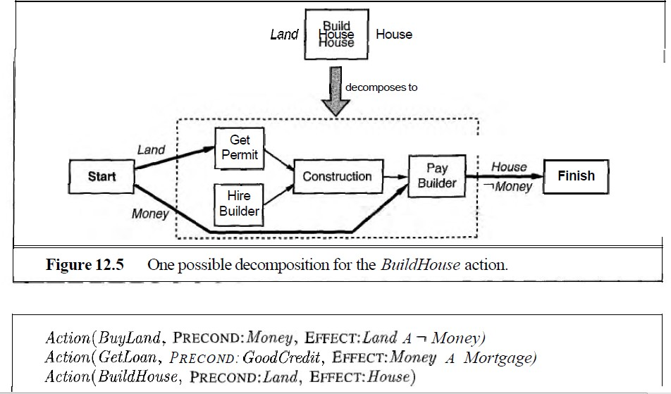

Slide 13
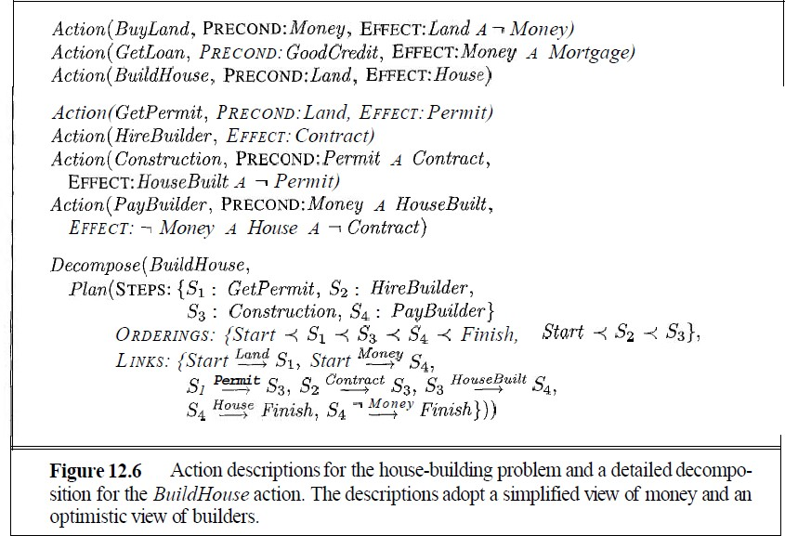

Slide 14
Non-Linear Planning in AI

Slide 15
Non-linear planning is a type of artificial intelligence planning that allows for flexibility in the order of actions and the interleaving of different planning steps. This approach is particularly useful for complex problems where the exact sequence of steps is not predetermined.

Slide 16
Key Characteristics of Non-Linear Planning:
Partial Ordering: The order of some actions is not specified, allowing for greater flexibility
and adaptability.
Interleaving: Different planning steps can be interleaved,
enabling simultaneous exploration of multiple possibilities.
Constraint Satisfaction: Non-linear planners must ensure that the planned
actions satisfy various constraints, such as resource limitations, preconditions, and postconditions.

Slide 17
Common Approaches to Non-Linear Planning:
1. Partial-Order Planning (POP): Focuses on creating a partially ordered plan that satisfies the goal while avoiding conflicts.
Uses techniques like constraint propagation and search algorithms to find feasible solutions.
2. Hierarchical Task Network (HTN) Planning: Decomposes complex tasks into simpler subtasks, forming a hierarchical structure.
Allows for flexibility in the order of subtasks and their decomposition.
3. Hybrid Planning: Combines elements of POP and HTN planning to leverage their respective strengths.
Can be particularly effective for complex problems with both hierarchical structure and flexibility.

Slide 18
Advantages of Non-Linear Planning:
Flexibility: Can handle complex problems with uncertain or changing conditions.
Efficiency: Can find solutions more efficiently than linear planning in some cases.
Adaptability: Can easily adapt to new information or changes in the environment

Slide 19
Challenges and Future Directions:
Scalability: Non-linear planning can be computationally expensive for large-scale problems.
Uncertainty: Dealing with uncertainty and unforeseen events remains a challenge.
Integration with Machine Learning: Combining non-linear planning with machine learning
techniques can improve performance and adaptability.

Slide 20
Applications of Non-Linear Planning:
Robotics: Planning paths for robots in complex environments.
Game AI: Developing intelligent agents for games that require strategic thinking.
Scheduling: Optimizing schedules for complex systems like transportation or manufacturing.
Problem-Solving: Finding solutions to complex problems in various domains,
such as logistics, planning, and decision-making.

Slide 21
Example: Planning a Robot's Path in a Complex Environment
Scenario:
A robot is tasked with navigating through a warehouse filled with obstacles to reach a specific location. The warehouse layout is dynamic, with objects constantly being moved or added.

Slide 22
Using Non-Linear Planning:
1.Define the Goal:
Reach the designated location.
2. Create a Partially Ordered Plan:
Identify potential paths to the goal.
Consider obstacles and constraints, such as narrow passages or weight limits.
Create a partially ordered plan, where some actions (e.g., turning left or right) may have flexible order.

Slide 23
3. Interleave Planning Steps:
As the robot moves, it can update its perception of the environment.
The plan can be modified in real-time to avoid new obstacles or take advantage of opportunities.
The robot can interleave planning steps with execution, allowing for more adaptive behavior.
4. Constraint Satisfaction:
Ensure that the robot's actions satisfy constraints, such as staying within the warehouse boundaries and avoiding collisions.
Use techniques like constraint propagation to identify and resolve conflicts.

Slide 24
STRIPS Representation of the Robot Path Planning Problem
Actions:
i) move(x, y): Move the robot to coordinates (x, y).
Preconditions: clear(x, y) , robot_at(x1, y1) (where (x1, y1) are the current coordinates)
Effects: robot_at(x, y) , not robot_at(x1, y1) , clear(x1, y1)
ii) clear(x, y) : Clear the space at coordinates (x, y)
→Preconditions: obstacle_at(x, y)
→Effects: not obstacle_at(x, y)

Slide 25
2. States:
→robot_at(x, y): The robot is at coordinates (x, y).
→obstacle_at(x, y): There is an obstacle at coordinates (x, y)
→clear(x, y): The space at coordinates (x, y) is clear.
3. Initial State:
→robot_at(x0, y0) (where (x0, y0) are the starting coordinates)
→obstacle_at(x1, y1) (for all obstacle locations)

Slide 26
4. Goal State:
robot_at(x_goal, y_goal) : (where (x_goal, y_goal) are the desired goal coordinates)
Planning Process:
Initial State: Start with the initial state.
Goal Test: Check if the current state matches the goal state. If yes, the planning process is complete.
Action Selection: Choose an action that is applicable in the current state (i.e., its preconditions are satisfied).
Transition: Apply the chosen action to the current state, resulting in a new state.
Repeat: Go back to step 2 and continue until the goal is reached or no applicable actions are found.

